Slide 2
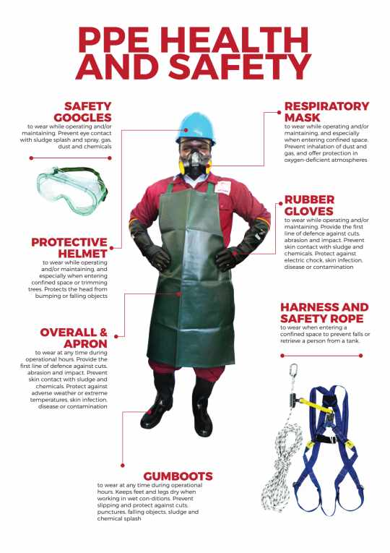
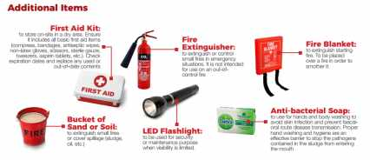
PERSONAL PROTECTIVE EQUIPMENT

Slide 3
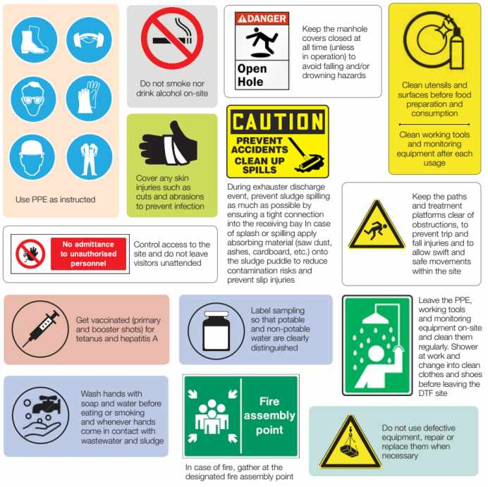
SAFETY MEASURES

Slide 4
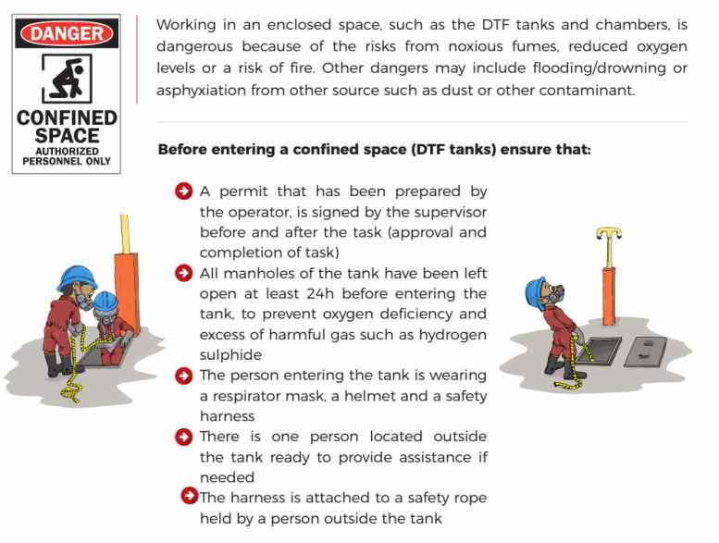
CONFINED ENTRY PROCEDURES

Slide 5
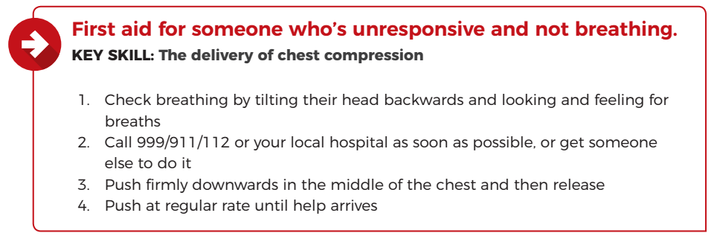
EMERGENCY PROCEDURES

Slide 6
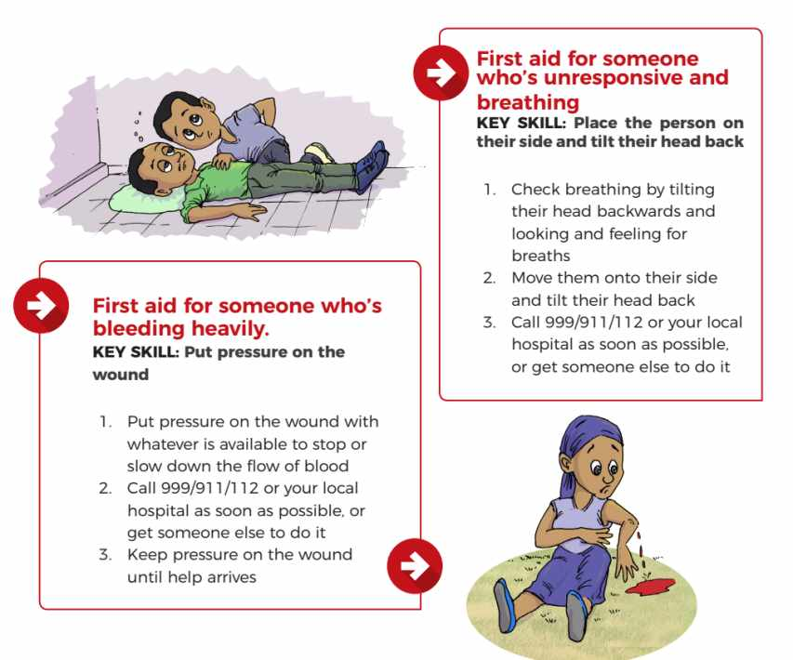

Slide 7
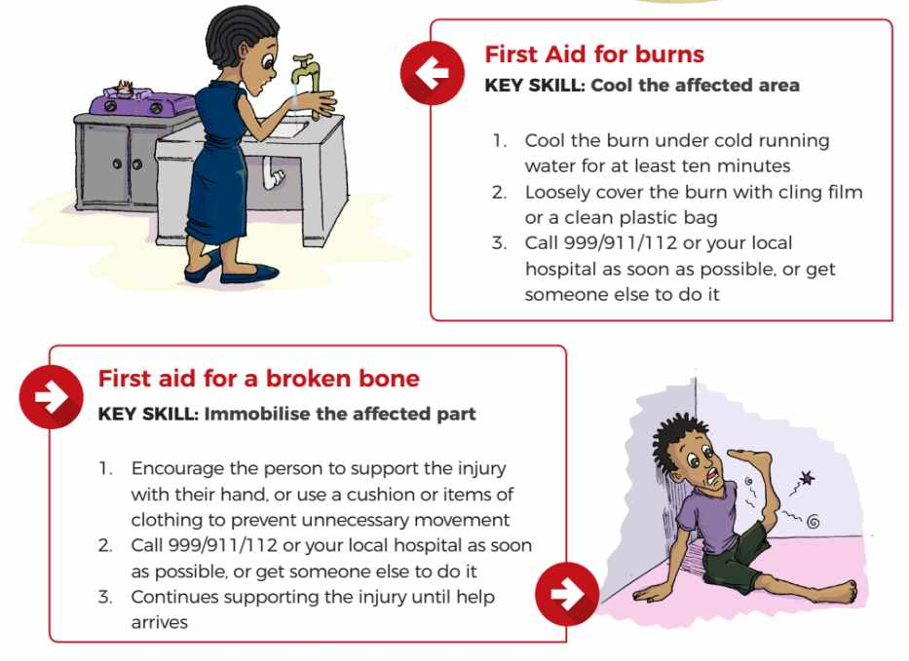

Slide 8
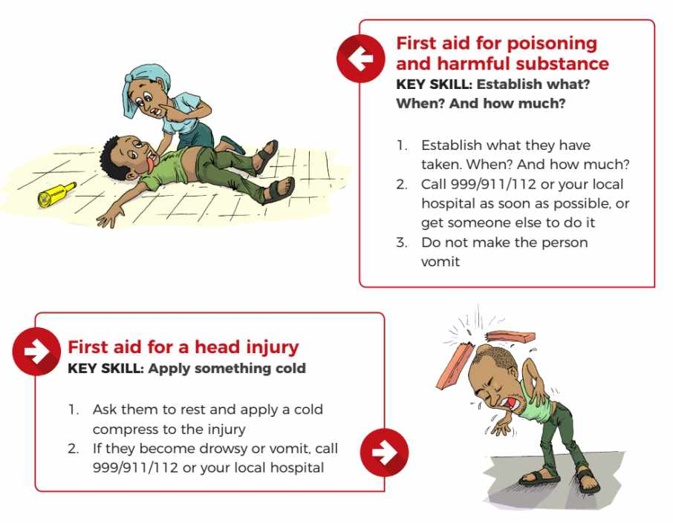

Slide 9
EMERGENCY CONTACTS

